Slide 1
Chapter 3
Federalism
American Democracy Now, 7th edition
Brigid Callahan Harrison
Jean Wahl Harris
Michelle D. Deardorff

Slide 2
An Overview of the U.S. Federal System
Federal system has two constitutionally recognized levels of government, each with sovereignty over different policy matters and geographic areas.
Sovereignty meaning ultimate governing authority, with no legal superior; dual sovereignty therefore refers to an arrangement of two levels of government.
American colonists’ experience with a unitary system, and subsequently the early U.S. citizens’ life under a confederal system (1781 to 1788), led to the creation of the innovative federal system.

Slide 3
Unitary System
Majority of world’s nations, including Great Britain, have unitary systems, in which the central government is the sovereign.
Central government can also unilaterally take away any responsibilities it has delegated to the regional governments it creates and can even eliminate the regional governments.

Slide 4
Confederal System
In a confederal system, several independent sovereign governments agree to cooperate on specified matters while each retains ultimate authority over all other governmental matters within its borders.
Cooperating sovereign governments delegate some responsibilities to a central governing body.
Sovereign governments retain ultimate authority.

Slide 5
Federal System
Constitution’s framers established dual sovereignty by detailing a new, sovereign national government for the United States and modifying the sovereignty of the existing state governments.
National government has no legal superior on matters over which the Constitution gives it authority.
State governments have no legal superior on the matters over which they are granted authority by the Constitution.

Slide 6
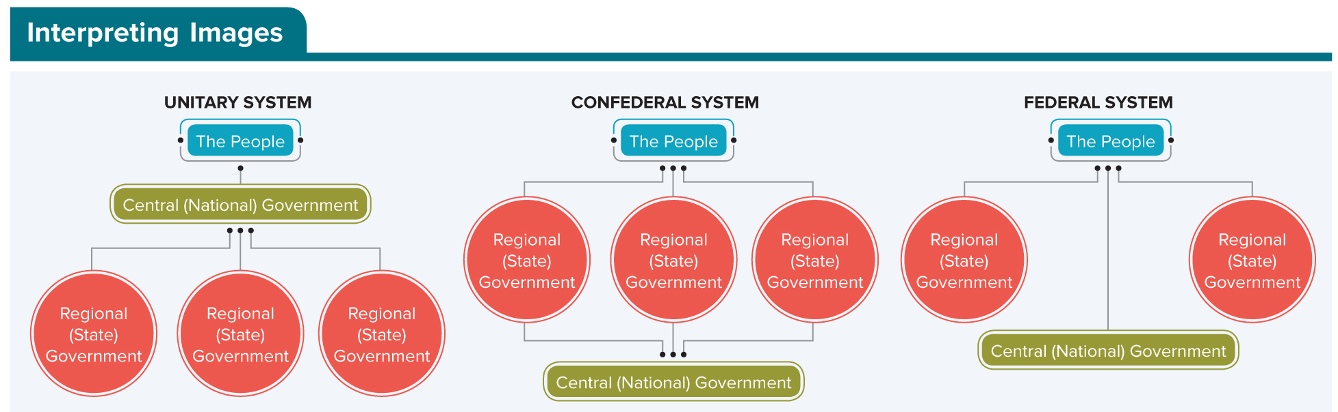
Figure 3.1 Three Governing Systems
In a unitary system, the sovereign central government creates, delegates power to, and can eliminate regional governments, which are not sovereign governments.
In a confederal system, the sovereign regional governments create, delegate power to, and can eliminate the central government, which is not a sovereign government.
In a federal system, the people create a sovereign central government as well as sovereign regional governments. Each of the two levels of sovereign governments (central and regional) is sovereign over different matters. Thus, dual sovereignty defines the federal system of government.
Access the text alternative for slide images.

Slide 7
What the Federal System Means for U.S. Citizens
Majority of U.S. citizens live under the jurisdiction of at least five governments: national, state, county, municipal or township, and school district.
Each of these governments can impose responsibilities on the people living in its jurisdiction.
For example, taxes.
Each government can also enact laws to regulate behaviors, as long as those laws do not violate the U.S. Constitution; and they can guarantee personal liberties and rights beyond those of the Bill of Rights.

Slide 8
Constitutional Distribution of Authority
By distributing some authority to the national government and different authority to the state governments, the Constitution creates the dual sovereignty that defines the U.S. federal system.
To fulfill their responsibilities to their citizens, both the national and the state governments have the authority to engage in the functions inherent to all sovereign governments.

Slide 9
Concurrent Powers
To function, sovereign governments need the authority to make policy, raise and spend money, implement policies, and establish courts to interpret law when a conflict arises about its meaning.
In the U.S. federal system, these basic governing powers are concurrent powers because the national and all state governments exercise them, independently and at the same time.

Slide 10
Table 3.1 Concurrent Powers of National and State Governments
Make policy.
Raise and spend money.
Borrow money.
Implement policy.
Charter banks and corporations.
Establish courts.
Take private property for public use (eminent domain).
Table summarizes concurrent powers of national and state governments.

Slide 11
National Sovereignty
Article I of the Constitution enumerates (lists) the matters over which Congress holds the authority to make laws—enumerated powers.
Constitution also gives Congress implied powers—that is, powers that are not explicitly described but that may be interpreted as necessary to fulfill the enumerated powers.
Congress specifically receives implied powers through the Constitution’s necessary and proper clause (or elastic clause).

Slide 12
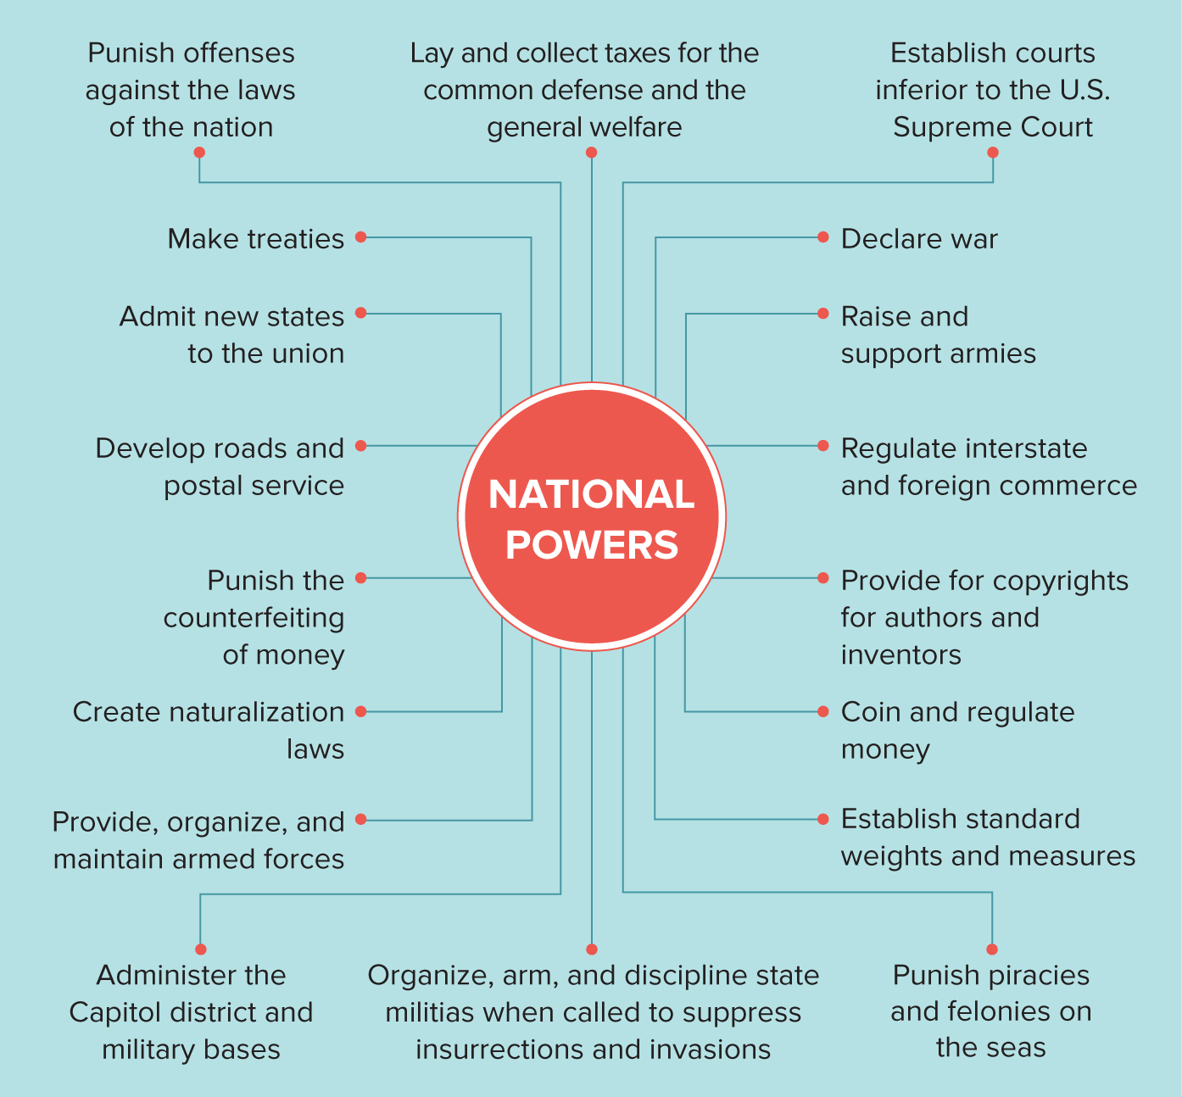
Figure 3.2 Enumerated Powers of National Government
Access the text alternative for slide images.

Slide 13
The Supremacy Clause
Unless the Supreme Court finds a national law to be outside of the enumerated or implied powers, that law is constitutional and hence the supreme law of the land, as defined by the supremacy clause in Article VI of the Constitution.

Slide 14
National Treaties with Indian Nations
Throughout U.S. history, the national government has signed treaties with Native American nations, which are legally considered sovereign foreign nations.
Today, the federal government recognizes more than 573 Indian tribes.
Even though Indian reservations lie within state borders, national treaties and national laws—not state or local laws—apply to the reservation populations and lands.
Native American treaty rights to hunt, fish, and gather on reservations and on public lands superseded, national, state, and local environmental regulations.

Slide 15
State Sovereignty
Broad set of powers are reserved to the states.
Tenth Amendment’s reserved powers clause acknowledges domestic matters under the state’s authority.
Powers to protect the health, safety, lives, and property of citizens are referred to as police powers.
Certain powers are delegated to the states.
State powers enumerated in the Constitution give the states a distinct voice in the composition and priorities of the national government.

Slide 16
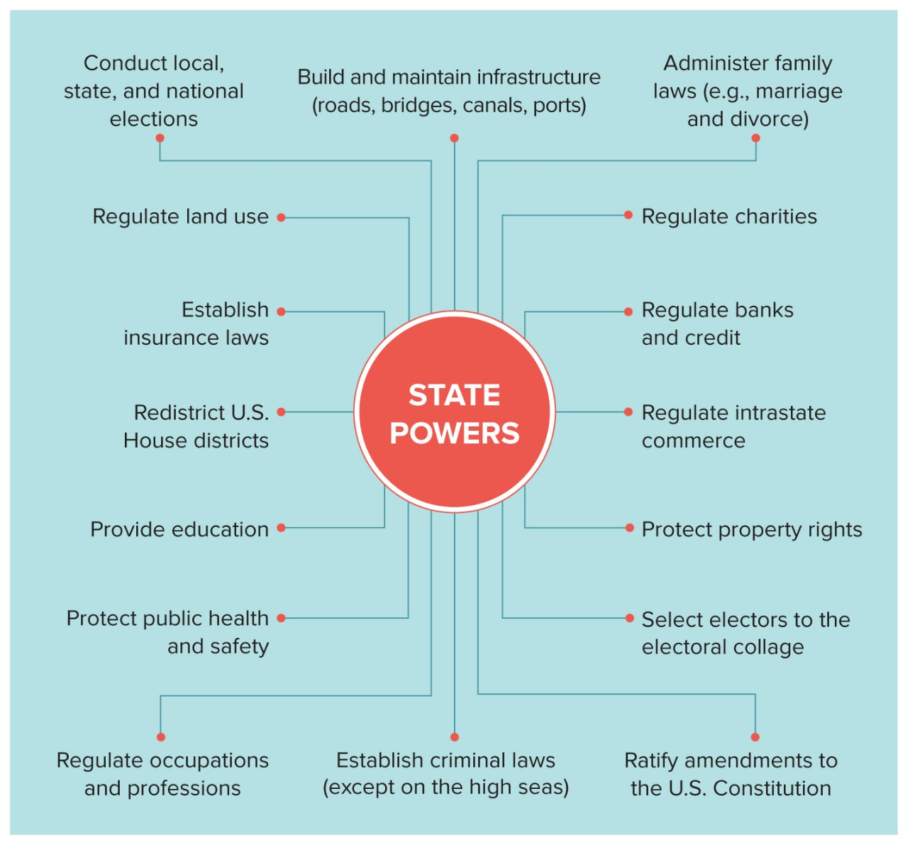
Figure 3.3 Constitutionally Delegated and Reserved Powers
Access the text alternative for slide images.

Slide 17
State-to-State Obligations: Horizontal Federalism
In Article IV, the Constitution sets forth obligations that the states have to one another and to each other’s citizens.
Collectively, these state-to-state obligations and the relationships they mandate are forms of horizontal federalism:
Interstate compacts.
Extradition.
Privileges and immunities.
Full faith and credit clause.

Slide 18
Supreme Court Interpretation of the Constitution
Constitution’s vague language continues to spark dispute over the national government’s powers versus what are the constitutional powers of the states.
McCulloch v. Maryland (1819) exemplifies a Supreme Court ruling that established the use of the implied powers to expand the national government’s enumerated authority.

Slide 19
The Power to Regulate Commerce
In McCulloch, Congress’s establishment of a national bank was contested; and the Supreme Court decided in the government’s favor.
Necessary and proper clause allows Congress to broadly interpret the enumerated powers of the national government.
In Gibbons v. Ogden (1824), the Supreme Court established a broad definition of commerce: “all commercial intercourse—meaning all business dealings.”

Slide 20
The Power to Provide for the General Welfare
In 1937, the Supreme Court had to decide if Social Security was a matter of general welfare for which Congress is delegated the authority to raise and spend money; or if Social Security was a matter for the state governments to address.
Court found the national policy to be constitutional— a reasonable congressional interpretation, the justices wrote, of the enumerated and implied powers of the national government.

Slide 21
Judicial Federalism
Judicial federalism: state courts’ use of their state constitutions to determine citizens’ rights, particularly when state constitutions guarantee greater protections than does the U.S. Constitution.
Practice began in the 1970s.

Slide 22
Table 3.2 National Government Obligations to the States
THE NATIONAL GOVERNMENT:
Must treat states equally in matters of the regulation of commerce and the imposition of taxes.
Must guarantee a republican form of government.
Must protect states from foreign invasion.
Must, at their request, protect states against domestic violence.
Cannot approve the creation of a new state from the property of an existing state without the consent of the states concerned.
Cannot change state boundaries without the consent of the states concerned.
Table summarizes six national government obligations to the states.

Slide 23
Evolution of Intergovernmental Relations in the U.S. Federal System
Federal system established by the Constitution has evolved from a simple system of dual federalism to a complex system of intergovernmental relations (IGR) characterized by conflicted federalism.

Slide 24
Table 3.3 Elements of Government Action
ELEMENT | DEFINITION
Policy statement | Plan of government action to address a public problem
Policy financing | Identification of government(s) that will pay the costs of policy implementation
Policy implementation | Employment of staff who will put the policy into action
Table divided into two columns summarizes elements of government action. The column headers are marked as: Element and definition.
SOURCE: Robert Jay Dilger, Federal Grants to State and Local Governments: A Historical Perspective on Contemporary Issues (Washington, D.C.: Congressional Research Service, 2017), 6.

Slide 25
Dual Federalism
Dual federalism refers to a relationship between the national and state governments whereby the two levels of government functioned independently of each other to address their distinct constitutional responsibilities.
Dominant between 1789 and 1932.

Slide 26
Cooperative Federalism
Cooperative federalism is a relationship between the national and state governments whereby the two levels of government work together to address domestic matters reserved to the states, driven by the policy priorities of the states.
Era began during the Depression.
Grants-in-aid—transfers of money from one level of government to another that need not be paid back (also known as intergovernmental transfers)—became a main mechanism of President Roosevelt’s New Deal programs.

Slide 27
Centralized Federalism
By the time of Lyndon Johnson’s presidency (1963 to 1969), a new kind of federalism was developing.
In centralized federalism, directives in national legislation force state and local governments to implement a particular national policy.
Presidents since Richard Nixon (1969 to 1974) have fought against this centralizing tendency.
Devolution refers to the return of policy responsibilities to state and local governments.

Slide 28
Partisan Federalism
Federalism scholars identify increased political polarization and gridlock in Congress that today fuel intergovernmental tensions.
Democrats controlling government in some states and Republicans in others.
One state government dominated by one party and Congress or the presidency controlled by the opposing one.
Partisan federalism: a preference for state or national government action that depends on policy substance and partisan makeup of government at the other levels.

Slide 29
Intergovernmental Tensions
Pace of lawsuits filed by state attorneys general against the national government has become extraordinary.
Cases regarding cooperation with federal immigration agents.
States’ legalization of marijuana, illegal under federal law.
Especially since the inauguration of President Trump, global issues regarding agreements to address climate change and issues of foreign trade.
Questions continue about the constitutional distribution of sovereignty between the national and state governments.

Slide 30
Tools of Intergovernmental Relations
Today, federal grants-in-aid are 17 percent of federal annual spending and pay for about one-third of total state government funding.
Fiscal federalism refers to the relationship between the national, state, and local governments that grows out of the grants of money that the national government provides to state and local governments.

Slide 31
Table 3.4 Fiscal Federalism: Largest Federal Intergovernmental Transfers (2019)
PROGRAM | COST (in billions)
Medicaid | $409
Highways | $45
Child Nutrition | $23
Tenant Based Rental Assistance (Section 8 Vouchers) | $22
Children’s Health Insurance Fund | $18
Temporary Assistance to Needy Families | $16
Accelerating Achievement and Ensuring Equity (Education for the Disadvantaged) | $16
Special Education | $13
State Children and Families Services Programs | $11
Urban Mass Transportation Grants | $11
TOTAL OUTLAYS FOR GRANTS TO STATES AND LOCALS | $721
Table divided into two columns summarizes fiscal federalism: Largest federal intergovernmental transfers (2019). The column headers are marked as: Program and cost (in billions).
Federal grants-in-aid provide approximately one-third of state and local government revenues. What information about each of these grant programs would you need to determine whether the program fits into the cooperative federalism model or the centralized federalism model?
SOURCE: Office of Management and Budget, Historical Tables, “Table 12.3: Total Outlays for Grants to State and Local Governments by Function, Agency and Program.”

Slide 32
Categorical Grants
Historically, the most common type of grant-in-aid has been the categorical formula grant.
Grant of money to state and local governments for a narrow purpose, as defined by the federal government.
One typical string is a matching funds requirement, which obligates the recipient to match a specific percentage with its own money.
Since the 1960s, the national government has also offered categorical project grants.
State and local governments propose specific projects they wish to implement and what level of funding they need.

Slide 33
Table 3.5 States That Pay More in Federal Taxes Than They Get Back
State | How much more is paid than is received in grants | How much more the average state resident paid than they received
New Jersey | $24.7 billion | $2,748
New York | $24.1 billion | $1,216
Illinois | $14.8 billion | $1,158
California | $13.7 billion | $348
Massachusetts | $10.5 billion | $1,532
Minnesota | $6.0 billion | $1,078
Connecticut | $4.4 billion | $1,242
New Hampshire | $749 million | $558
Nebraska | $267 million | $139
Utah | $236 million | $76
Wyoming | $169 million | $291
Table divided into three columns summarizes states that pay more in federal taxes than they get back. The column headers are marked from left to right as: State, how much more is paid than is received in grants, and how much more the average state resident paid than they received.
SOURCE: Hillary Hoffower, “States Pay More in Federal Taxes than They Get Back,” Business Insider, January 14, 2019, www.businesinsider.com/federal-taxes-federal-services-differences-by-state-2019-1.

Slide 34
Block Grants
Block grants consist of money granted by the national government to states or localities for broadly defined policy areas, with fewer strings than categorical grants, and in amounts based on complicated formulas.
Today the number and specificity of conditions included in block grants are increasing.
Although the states welcome federal grant money, they do not welcome the strings attached to the funds, or mandates.

Slide 35
Mandates
Mandates are portions of federal laws that require state and local governments to do something.
Funded mandate: the national government pays the entire cost.
Unfunded mandate: state and local governments must pay all or part of the cost.
Waivers: exemptions from particular conditions normally attached to grants.

Slide 36
Preemption
Preemption is a constitutionally based principle that allows a national law to supersede state or local laws.
People must obey, and states must enforce, the national law even if state or local government has its own law on the matter.
Preemption is common in environmental policy.
States can enact laws that offer more rights and liberties than does national law.

Slide 37
Nullification
Nullification is a legal theory that state governments have the authority to invalidate national actions they deem unconstitutional.
True nullification: when a state law explicitly declares the national law unconstitutional.
Non-acquiescence nullification: when state law claims the state will not cooperate with a national law.
Inconsistent legislation nullification, the most common form: when state law conflicts with or attempts to alter the rules or procedures enacted in an existing law.

Slide 38
Advantages and Disadvantages of Today’s Federalism
One person’s advantage can look like a disadvantage to another.
Numerous access points for citizens to participate—but this can be confusing and time consuming.
Flexibility that makes for more efficient, effective, and responsive government—but this may lead to duplication of effort as multiple governments enact policies to address the same concern.
One clear disadvantage: inequalities in services and policies, leading to conflicts that may have to be resolved in the courts.

Slide 39
Review 1
Then—The newly created national government and the preexisting state governments acted independently as they implemented the innovative federal system of government established in 1789.
Now—National, state, and local governments challenge one another regularly over the proper interpretation of the Constitution’s vague and ambiguous distribution of power in the federal system of U.S. government.

Slide 40
Review 2
Next:
Will Supreme Court justices continue to issue conflicting interpretations of the proper balance of power in the federal system of government?
Will state and local governments continue their policy experiments to find more effective means of addressing domestic problems?
Will partisan differences between state governments and the national government perpetuate lawsuits brought by each level of government?

Slide 41
Questions?

Slide 42
End of Main Content

Slide 43
Accessibility Content: Text Alternatives for Images

Slide 44
Figure 3.1 Three Governing Systems - Text Alternative
Return to parent-slide containing images.
As diagrammed, in the unitary system the central (national) government is between the People and the regional (state) governments.
In the confederal system, it is the regional (state) governments that are between the People and the central (national) government—because the people create the regional (state) governments, and the regional (state) governments create (and can eliminate) the central (national) government.
In the federal system, the people create both the central (national) government and the regional (state) governments. As diagrammed, the regional (state) governments are closer to the People than to the central (national) government, but the people still have a relationship with the central (national) government outside or in addition to their relationship to a regional (state) government.
Return to parent-slide containing images.

Slide 45
Figure 3.2 Enumerated Powers of the National Government - Text Alternative
Return to parent-slide containing images.
Lay and collect taxes for the common defense and the general welfare.
Punish offenses against the laws of the nation.
Make treaties.
Admit new states to the union.
Develop roads and postal service.
Punish the counterfeiting of money.
Create naturalization laws.
Provide, organize, and maintain armed forces.
Administer the Capitol district and military bases.
Organize, arm, and discipline state militias when called to suppress insurrections and invasions.
Establish courts inferior to the U.S. Supreme Court.
Declare war.
Raise and support armies.
Regulate interstate and foreign commerce.
Provide for copyrights for authors and inventors.
Coin and regulate money.
Establish standard weights and measures.
Punish piracies and felonies on the seas.
Return to parent-slide containing images.

Slide 46
Figure 3.3 Constitutionally Delegated and Reserved State Powers - Text Alternative
Return to parent-slide containing images.
Build and maintain infrastructure (roads, bridges, canals, ports).
Conduct local, state, and national elections.
Regulate land use.
Establish insurance laws.
Redistrict U.S. House districts.
Provide education.
Protect public health and safety.
Regulate occupations and professions.
Establish criminal laws (except on the high seas).
Ratify amendments to the U.S. Constitution.
Administer family laws (e.g., marriage and divorce).
Regulate charities.
Regulate banks and credit.
Regulate intrastate commerce.
Protect property rights.
Select electors to the electoral collage.
Return to parent-slide containing images.

